Slide 1


Translational Equilibrium

Slide 2

Translational Equilibrium
For a rigid body to be in TRANSLATIONAL equilibrium, the sum of the forces must be zero
What did Newton say about that?

Slide 3

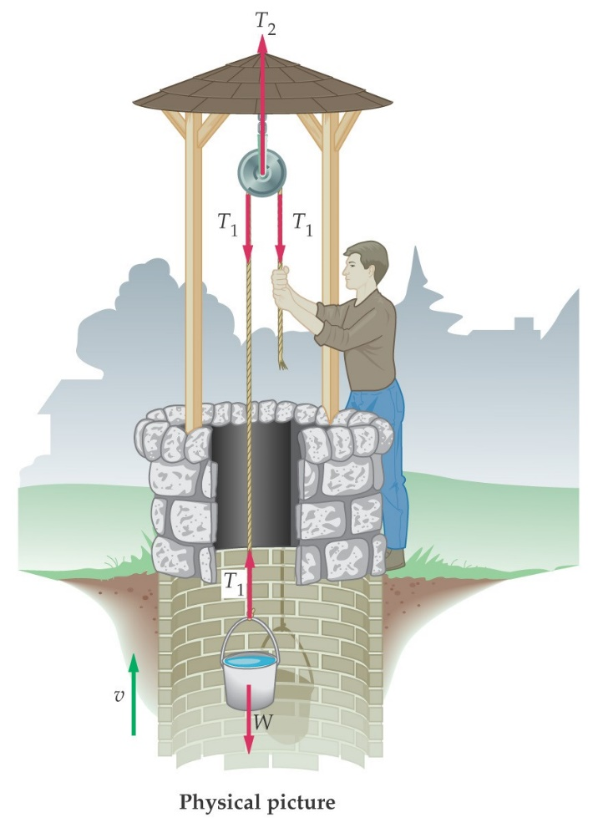
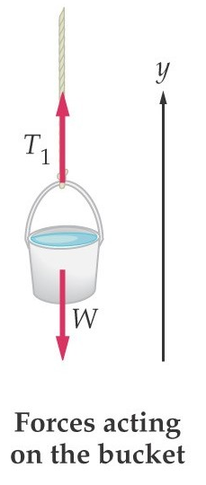
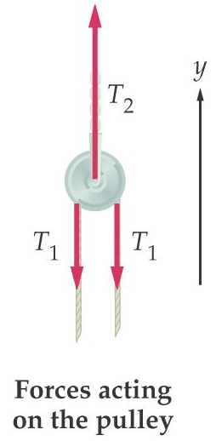
Translational Equilibrium
.
How do the downward forces T1, compare to T2? When there is no acceleration.
How do the two tensions T1, compare to T2?
Conclusion: apart from changing the direction of the required force, this pulley does not change the force required to lift the bucket.

Slide 4
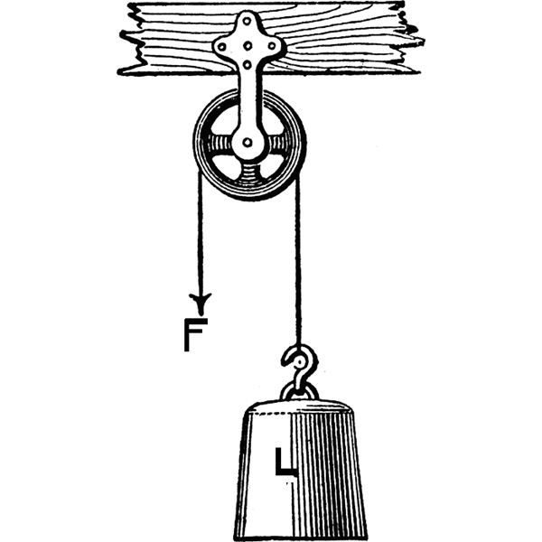
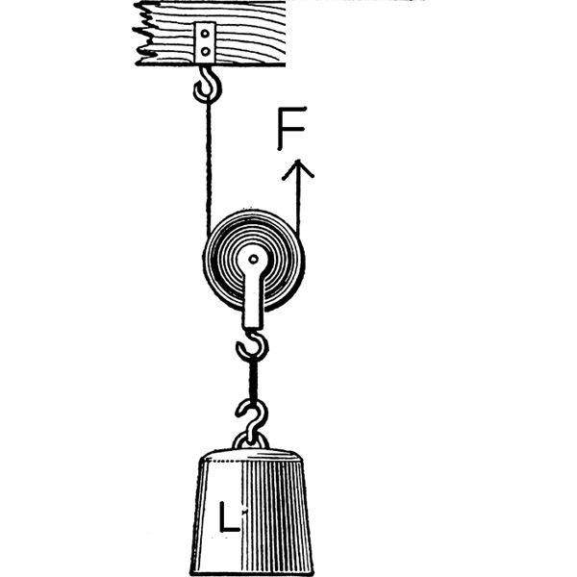
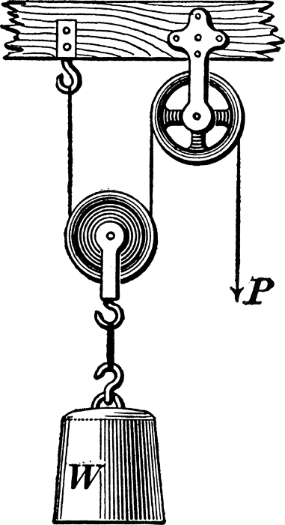
Translational Equilibrium
F = L
(pulley changes
direction only)
P = ½ W
(moveable pulley divides force, second changes direction only)
F = ½ L
(pulley divides force)

Slide 5
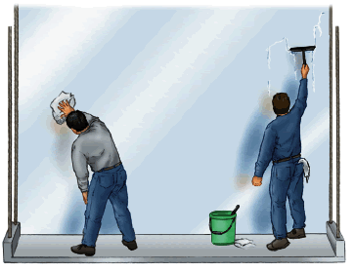
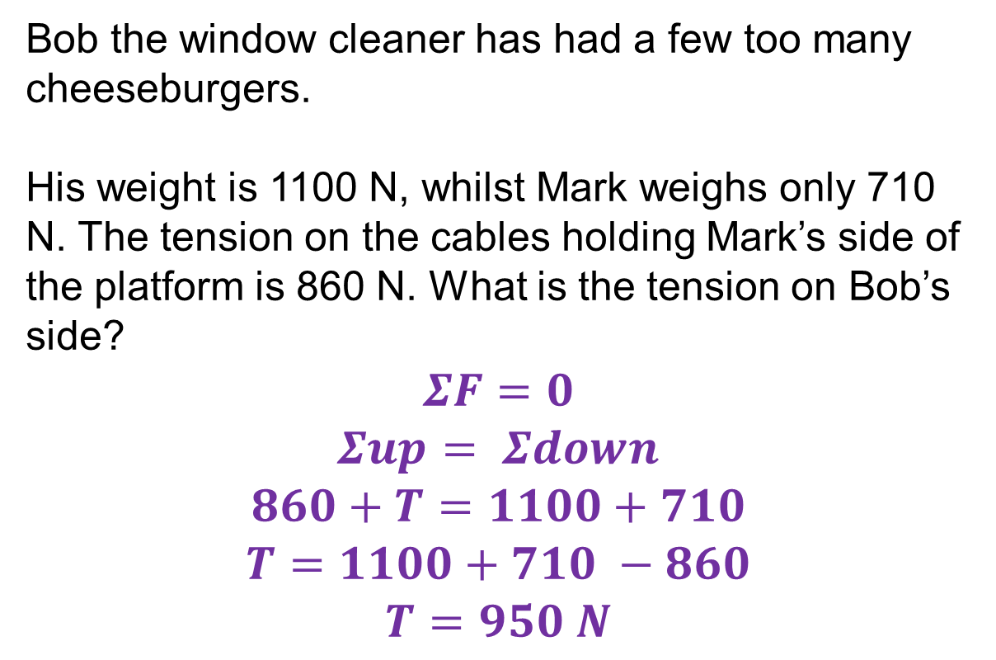
Simple Translational Equilibrium Problems
Bob the window cleaner has had a few too many cheeseburgers.
His weight is 1100 N, whilst Mark weighs only 710 N. The tension on the cables holding Mark’s side of the platform is 860 N. What is the tension on Bob’s side?
$$ΣF=0$$
$$Σup= Σdown$$
$$860+T=1100+710$$
$$T=1100+710 −860$$
$$T=950 N$$
860 N
1100 N
710 N

Slide 6
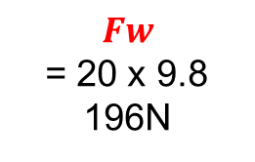


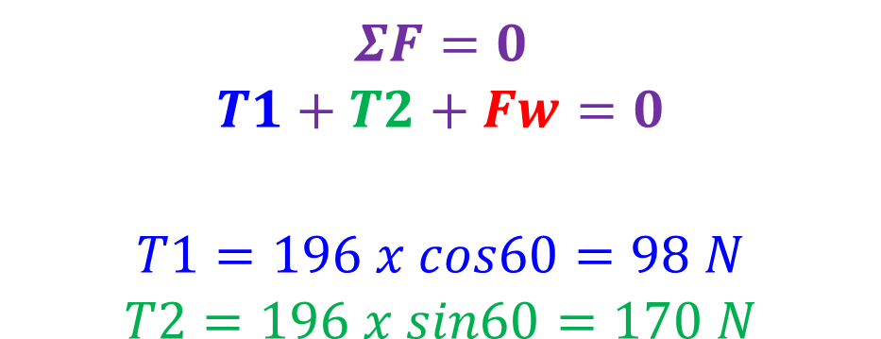
2 D Hanging Problem 1
A traffic light set is hung from 2 cable attached to a pole as shown. The Traffic lights have a mass of 20.0 kg. What is the tension in each of the two cables?
$$ΣF=0$$
$$T1+T2+Fw=0$$
$$T1=196 x cos60=98 N$$
$$T2=196 x sin60=170 N$$
$$Fw$$
= 20 x 9.8
196N
30⁰
$$T2$$
60⁰
$$T1$$
NOTE – Force is not necessarily proportional to length of the cables.

Slide 7
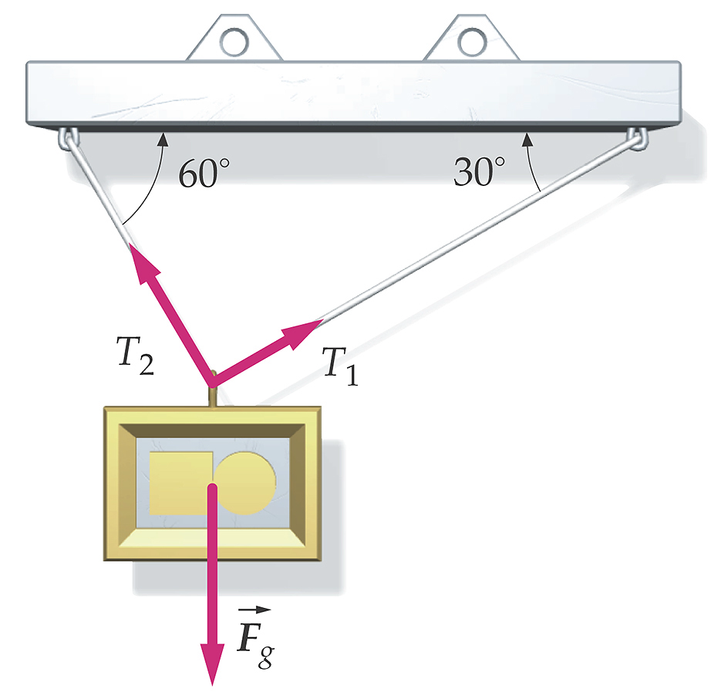
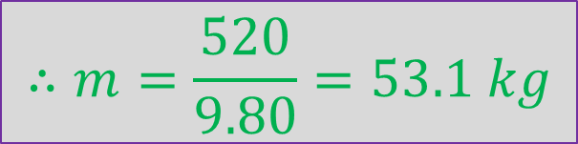



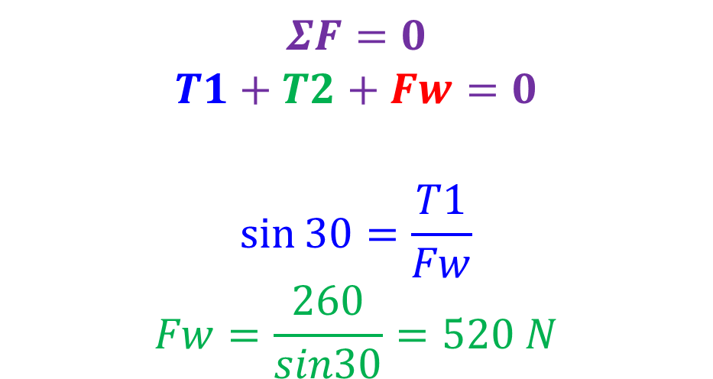
2 D Hanging Problem 2
Two cables hold a sign from a support as shown. If T1 has a tension of 260N, what is the mass of the sign?
$$ΣF=0$$
$$T1+T2+Fw=0$$
$$\sin{30=\frac{T1}{Fw}}$$
$$Fw=\frac{260}{sin30}=520 N$$
$$Fw$$
30⁰
$$T2$$
60⁰
$$∴m=\frac{520}{9.80}=53.1 kg$$
$$T1=260N$$

Slide 8
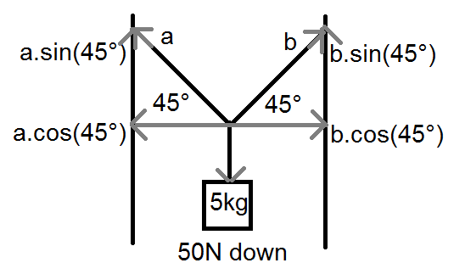
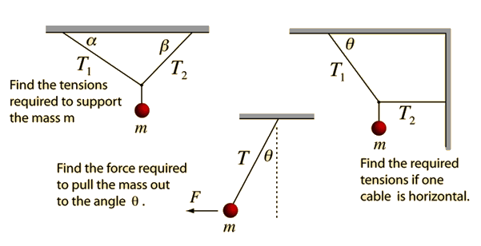
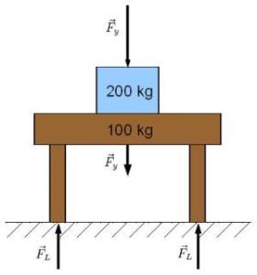
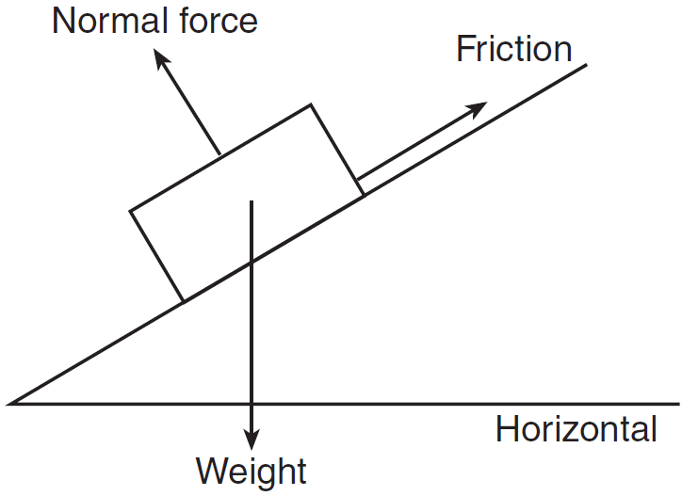
Other possible situations

Slide 9
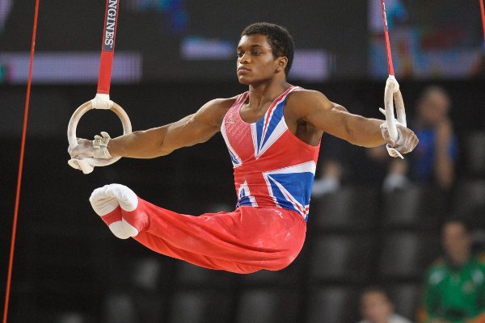
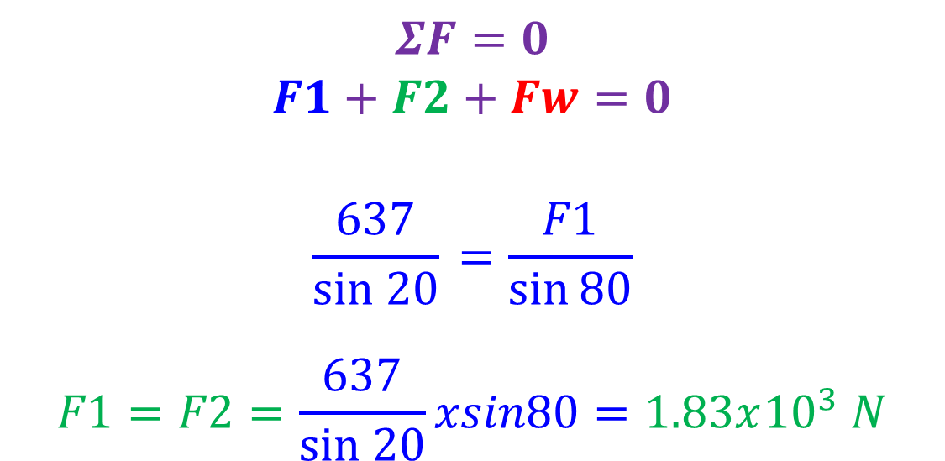



2 D Hanging Problem 3
An Olympic gymnast lifts his 65.0 kg body mass on the rings using the strength of his arms as shown. Each arm is angled downwards 10.0 degrees from horizontal. What is the force directed up each arm from the rings?
$$ΣF=0$$
$$F1+F2+Fw=0$$
$$\frac{637}{sin 20}{ =\frac{F1}{\sin{80}}}$$
$$F1=F2=\frac{637}{sin 20}xsin80=1.83x{10}^{3} N$$
10⁰
$$F2$$
80⁰
$$Fw$$
637N
20⁰
$$F1$$
10⁰

